Slide 1
Segura De La Sierra Fire in 2017: Evaluating forest loss and regrowth
Simone Santoro – spatial ecology in r, a.Y. 2024/2025
github repository

Slide 2
Project Overview
Event: On August 3 2017, at 19:00 CEST, a forest fire in municipality of Segura De La Sierra begun. Natural Park of Cazorla and Segura y Las Villas were affected. The fire spread to other nearby municipalities such as Orcera.
Objective: Analyzing forest loss and recovery in Segura De La Sierra utilizing R and remote sensing techniques.
Methodology:
Image acquisition and visualization;
K-Means clustering and class frequency analysis;
Normalized Difference Vegetation Index Analysis;
Time series analysis for monitoring Forest Recovery.

Slide 3
Software Requirements
Installation and loading of required packages:
install.packages(c("terra", "patchwork", "ggplot2", "devtools")) library(devtools) devtools::install_github("ducciorocchini/imageRy", force = TRUE) library(terra) library(ggplot2) library(patchwork) library(imageRy)

Slide 4
Image Acquisition
Acquisition: Images acquired by Sentinel-2 were downloaded on Copenicus Browser. The process involved the following steps:
Identification of Region of interest;
Browsing for images acquired with good cloud condition;
Selecting appropriate bands (NIR, Red and Green);
Download as high resolution .tiff 8-bit images.

Slide 5
Image Visualization
Loading Images:
# Define file paths for pre-fire and post-fire images pre_fire_path <- "data/2017-07-28/2017-07-28-00_00_2017-07-28-23_59_Sentinel-2_L2A_False_Color.tiff" post_fire_path <- "data/2017-08-07/2017-08-07-00_00_2017-08-07-23_59_Sentinel-2_L2A_False_Color.tiff" # Import the images as raster objects pre_fire <- rast(pre_fire_path) post_fire <- rast(post_fire_path)
Plotting:
# Display the false-color composites using the default band order: # Assumes: Band 1 = NIR, Band 2 = Red, Band 3 = Green par(mfrow = c(1, 2)) plotRGB(pre_fire, r = 1, g = 2, b = 3, main = "Pre-Fire 28-07-2017") plotRGB(post_fire, r = 1, g = 2, b = 3, main = "Post-Fire 07-08-2017")

Slide 6
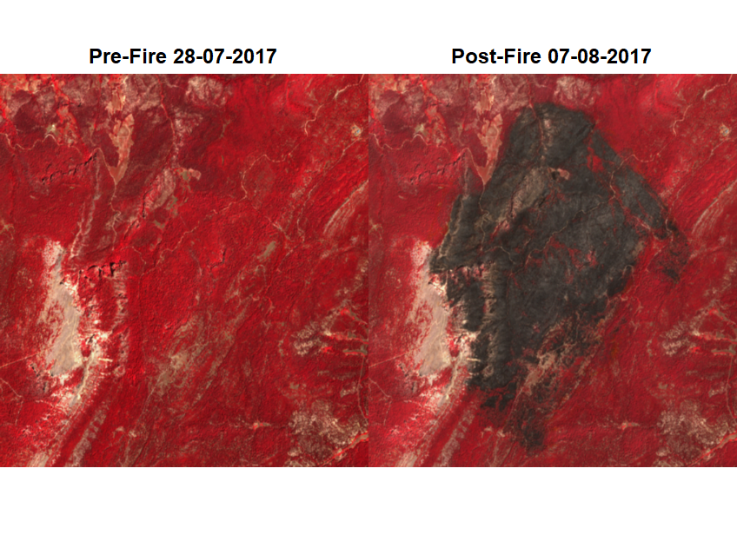
Image Visualization

Slide 7
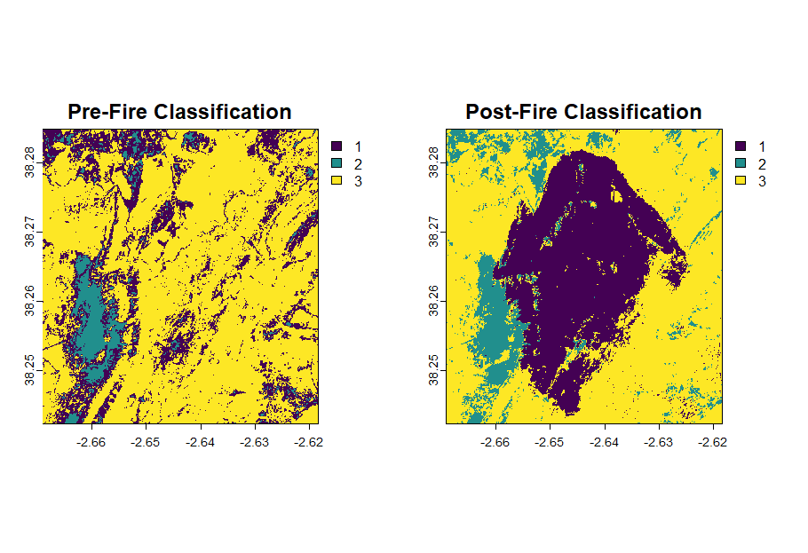
Classification – K-means and Visualization
K-Means clustering algorithm was used to classify pixels in 3 classes:
# Perform K-Means clustering with 3 clusters on both pre-fire and post-fire images pre_fire_cl <- im.classify(pre_fire, num_clusters = 3) post_fire_cl <- im.classify(post_fire, num_clusters = 3)
Outcome of classification was plotted:
par(mfrow = c(1, 2)) plot(pre_fire_cl, main = "Pre-Fire Classification") plot(post_fire_cl, main = "Post-Fire Classification")

Slide 8
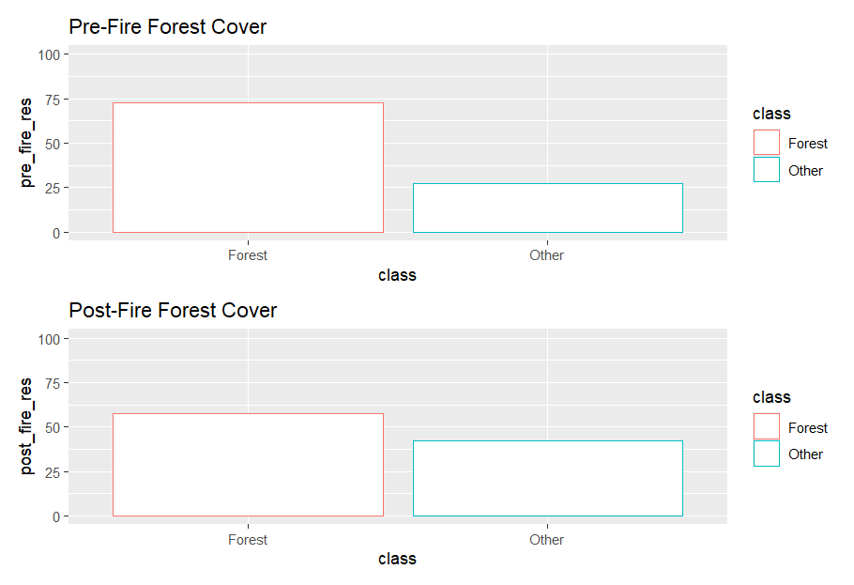
Classification – Forest Loss Evaluation
Class frequency computation and Percentage of Forest Cover:
# Retrieve the frequency of each class in the classified images pre_fire_freq <- freq(pre_fire_cl) post_fire_freq <- freq(post_fire_cl) # Calculate the percentage of each class relative to the total number of pixels pre_fire_percentage <- pre_fire_freq * 100 / ncell(pre_fire_cl) post_fire_percentage <- post_fire_freq * 100 / ncell(post_fire_cl)
CLASS | Pre-Fire | Post-Fire
Forest | 72,8 | 57,5
Other | 27,2 | 42,5

Slide 9
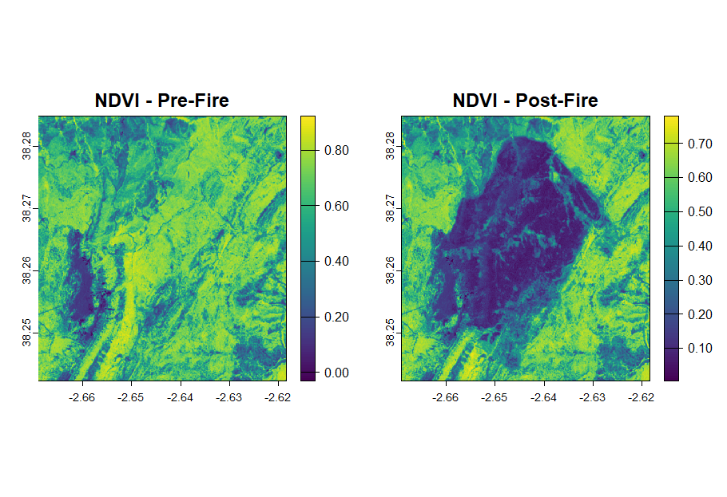
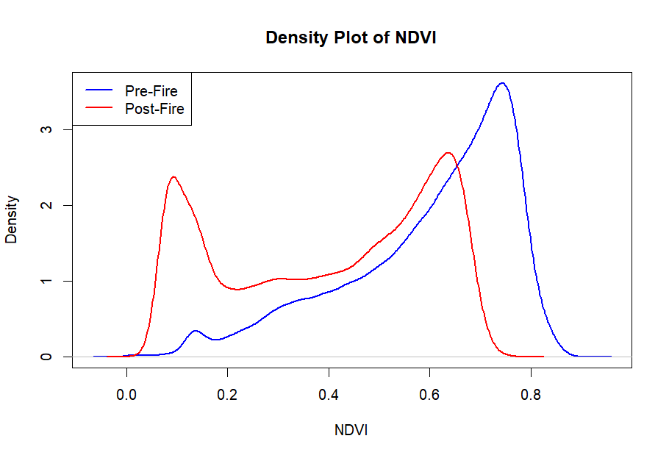
NDVI – Computation
NDVI is an important metric to quantify vegetation health and density using NIR and Red bands:
# NDVI = (NIR - Red) / (NIR + Red) ndvi_pre <- (pre_fire[[1]] - pre_fire[[2]]) / (pre_fire[[1]] + pre_fire[[2]]) ndvi_post <- (post_fire[[1]] - post_fire[[2]]) / (post_fire[[1]] + post_fire[[2]])
Density plot analysis:
# Extract pixel values from the NDVI rasters ndvi_pre_vals <- values(ndvi_pre) ndvi_post_vals <- values(ndvi_post) # Remove NA values from the extracted vectors ndvi_pre_vals <- ndvi_pre_vals[!is.na(ndvi_pre_vals)] ndvi_post_vals <- ndvi_post_vals[!is.na(ndvi_post_vals)] # Density plot for NDVI dev.off() plot(density(ndvi_pre_vals), main = "Density Plot of NDVI", xlab = "NDVI", col = "blue", lwd = 2) lines(density(ndvi_post_vals), col = "red", lwd = 2)

Slide 10
NDVI – Vegetation Loss Analysis
Computation of vegetated area as percentage of pixel with NDVI > 0.4:
vegetated_pre <- sum(values(ndvi_pre) > 0.4, na.rm = TRUE) / ncell(ndvi_pre) * 100 vegetated_post <- sum(values(ndvi_post) > 0.4, na.rm = TRUE) / ncell(ndvi_post) * 100
Percentage vegetated areas before fire: 85,12%
Percentage vegetated areas after fire: 54,69%
Computation of NDVI difference and result visualization:
ndvi_diff <- ndvi_post - ndvi_pre … # Plot the NDVI difference map plot(ndvi_diff, main = "NDVI Difference (Post-Fire - Pre-Fire)") # Plot a histogram of NDVI differences hist(ndvi_diff, main = "Histogram of NDVI Differences", xlab = "NDVI Difference", col = "lightblue")

Slide 11
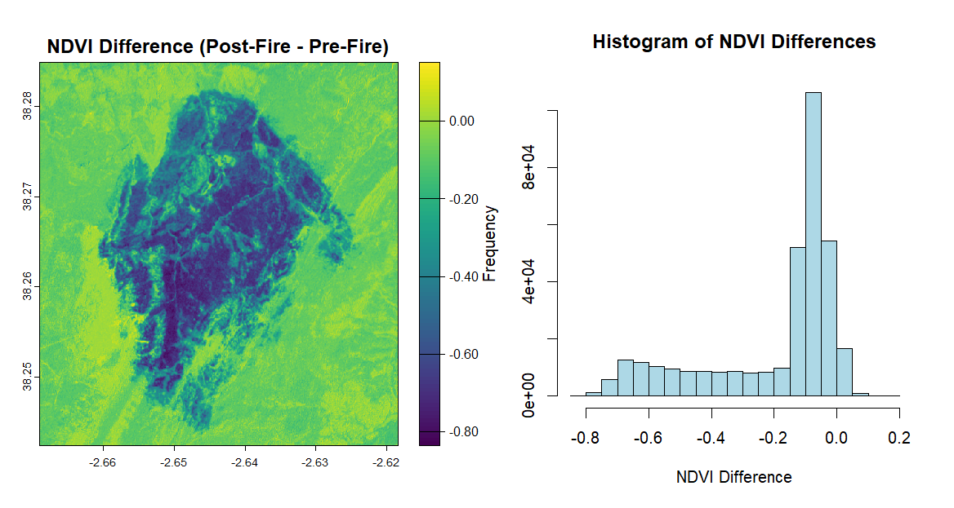
NDVI – Vegetation Loss Analysis

Slide 12
Time Series Analysis – Forest regrowth
An image acquired each year from 2017 to 2024 (August) was downloaded and loaded.
Empty vectors for containing mean NDVI values and forest cover percentage for each year were created:
# Initialize vectors to store metrics for each year mean_ndvi_vec <- numeric(length(years)) forest_cover_perc_vec <- numeric(length(years))
A for-loop was used to cycle over all the images, computing metrics for each one. Results were stored in vectors.
A dataframe containing results was created and used to plot regrowth trends:
# Combine the results into a data frame for visualization and analysis ts_data <- data.frame( Year = years, Mean_NDVI = mean_ndvi_vec, Forest_Cover_Percentage = forest_cover_perc_vec )

Slide 13
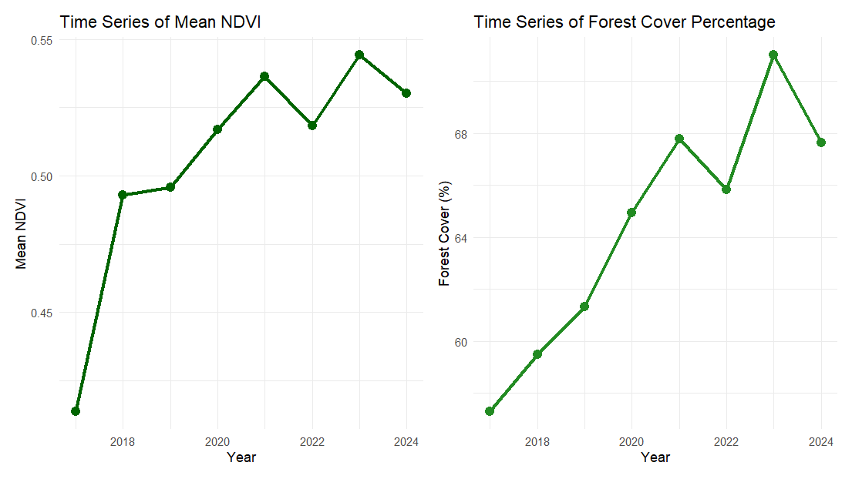
Time Series Analysis – Forest regrowth

Slide 14
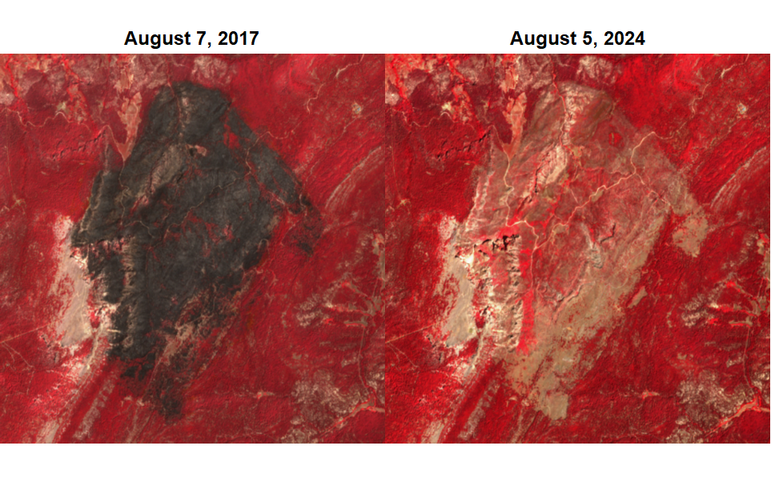
Forest Regrowth

Slide 15
Conclusions
Reduction of Average NDVI: Average NDVI dropped from 0.6 to 0.4
Significant Vegetation Loss: NDVI analysis revealed a sharp decline in vegetated areas, dropping from 85.12% before the fire to 54.69% after.
Image Classification: K-means clustering and NDVI proved effective in quantifying fire-induced forest loss.
Gradual Forest Recovery: Time series analysis from 2017 to 2024 showed a positive trend in NDVI and forest cover percentage, indicating progressive regrowth.
Future Development: Further analysis could incorporate climate variables and soil conditions to refine recovery assessments. Also, machine learning models could be developed to predict regrowth in the following years.

Slide 16
THANK YOU FOR THE ATTENTION!

